Slide 1

ANGULAR 4

Slide 2
Form Validation
CSS Classes for Validation
ngModel Validation Properties
Showing Error Messages
Styling Controls for Errors
HTML 5 Attributes for Validation
Validating a Select Control
More on Select Control Validation
Form Level Validation
Disabling the Submit Button

Slide 3
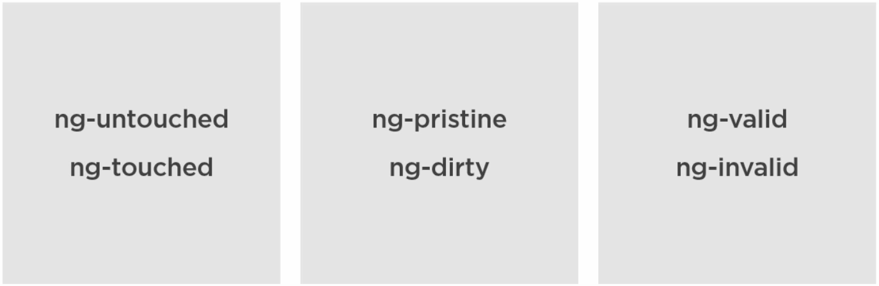
CSS CLASSES FOR VALIDATION

Slide 4
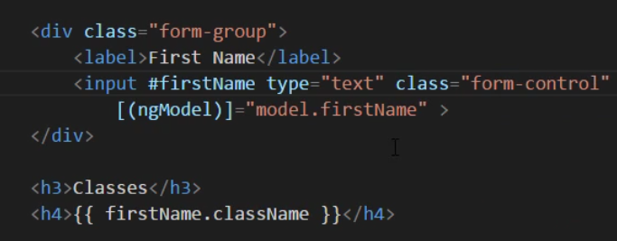
CSS VALIDATION CLASSES IN ACTION
DEMO

Slide 5
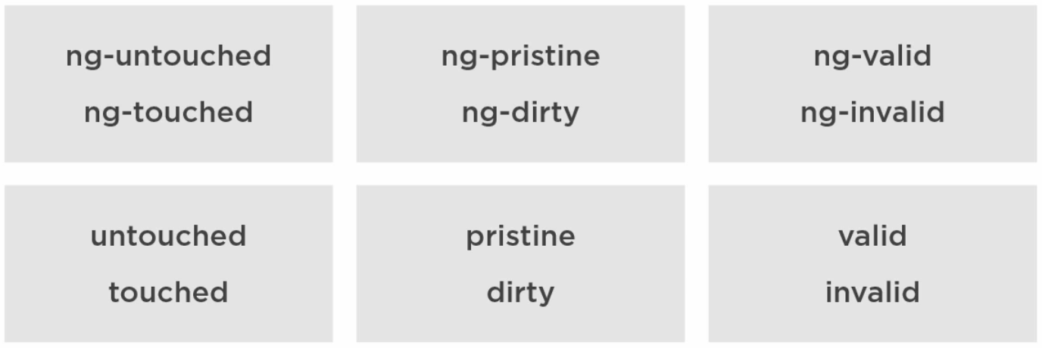
NGMODEL VALIDATION PROPERTIES

Slide 6
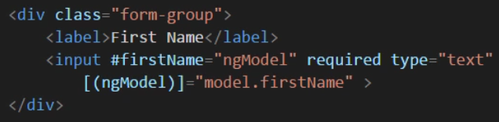
NGMODEL VALIDATION PROPERTIES
DEMO

Slide 7
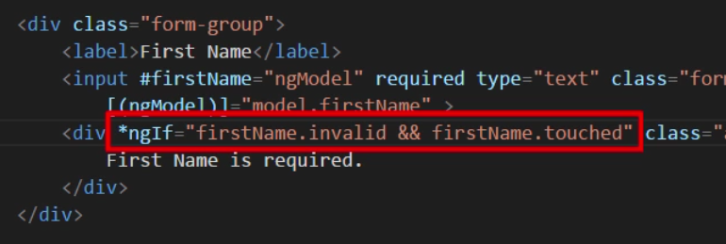
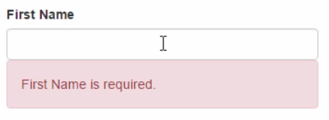
SHOWING ERROR MESSAGES

Slide 8
SHOWING ERROR MESSAGES
DEMO

Slide 9
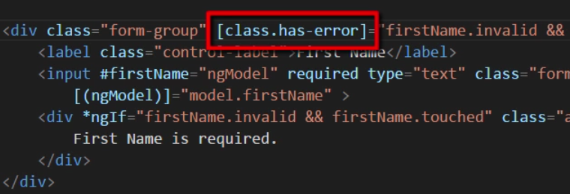
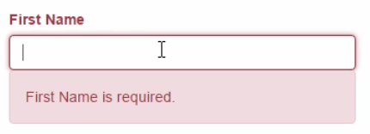
STYLING CONTROLS FOR ERRORS

Slide 10
STYLING CONTROLS FOR ERRORS
DEMO

Slide 11
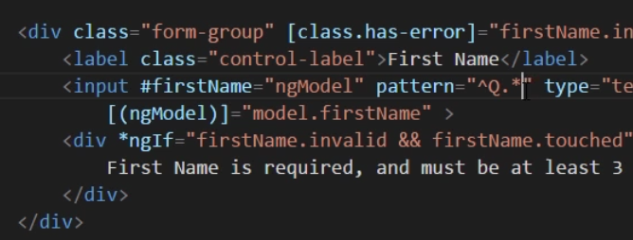
HTML 5 ATTRIBUTES FOR VALIDATION
http://caniuse.com/
required
maxlength
minlength
pattern
Regular expressions

Slide 12
HTML 5 ATTRIBUTES FOR VALIDATION
DEMO

Slide 13
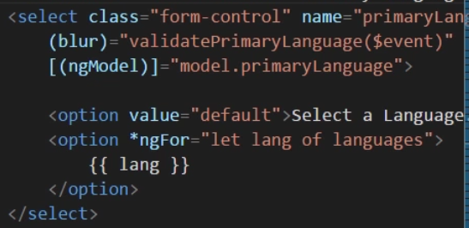
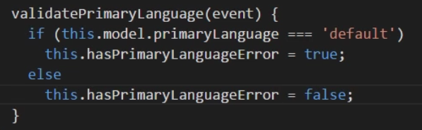
VALIDATING A SELECT CONTROL
On select html controls we need to user event binding.

Slide 14
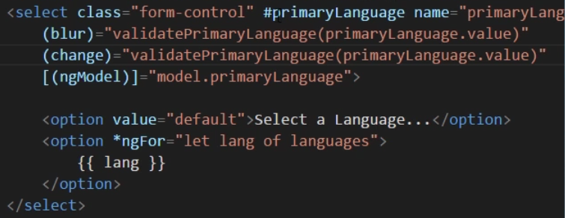
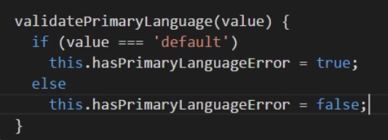
MORE ON SELECT CONTROL VALIDATION

Slide 15
MORE ON SELECT CONTROL VALIDATION
DEMO

Slide 16
FORM LEVEL VALIDATION
We use the same properties on the form level.

Slide 17

DISABLING THE SUBMIT BUTTON
We use property binding has any other control.

Slide 18
DISABLING THE SUBMIT BUTTON
DEMO

